Slide 1

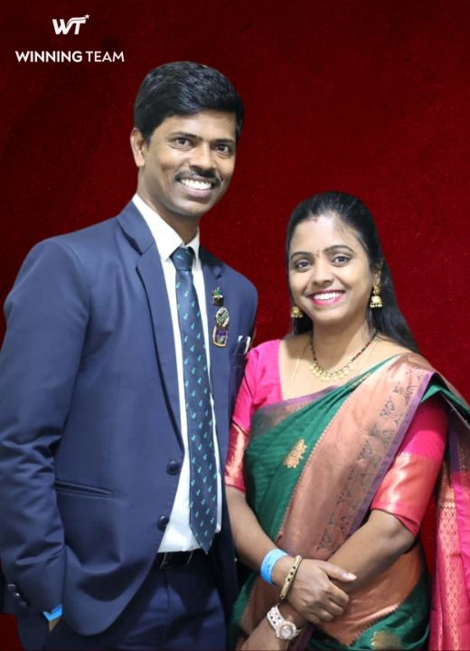
CEP
MOVEMENT
Lavanya-Ashok DUCD

Slide 2
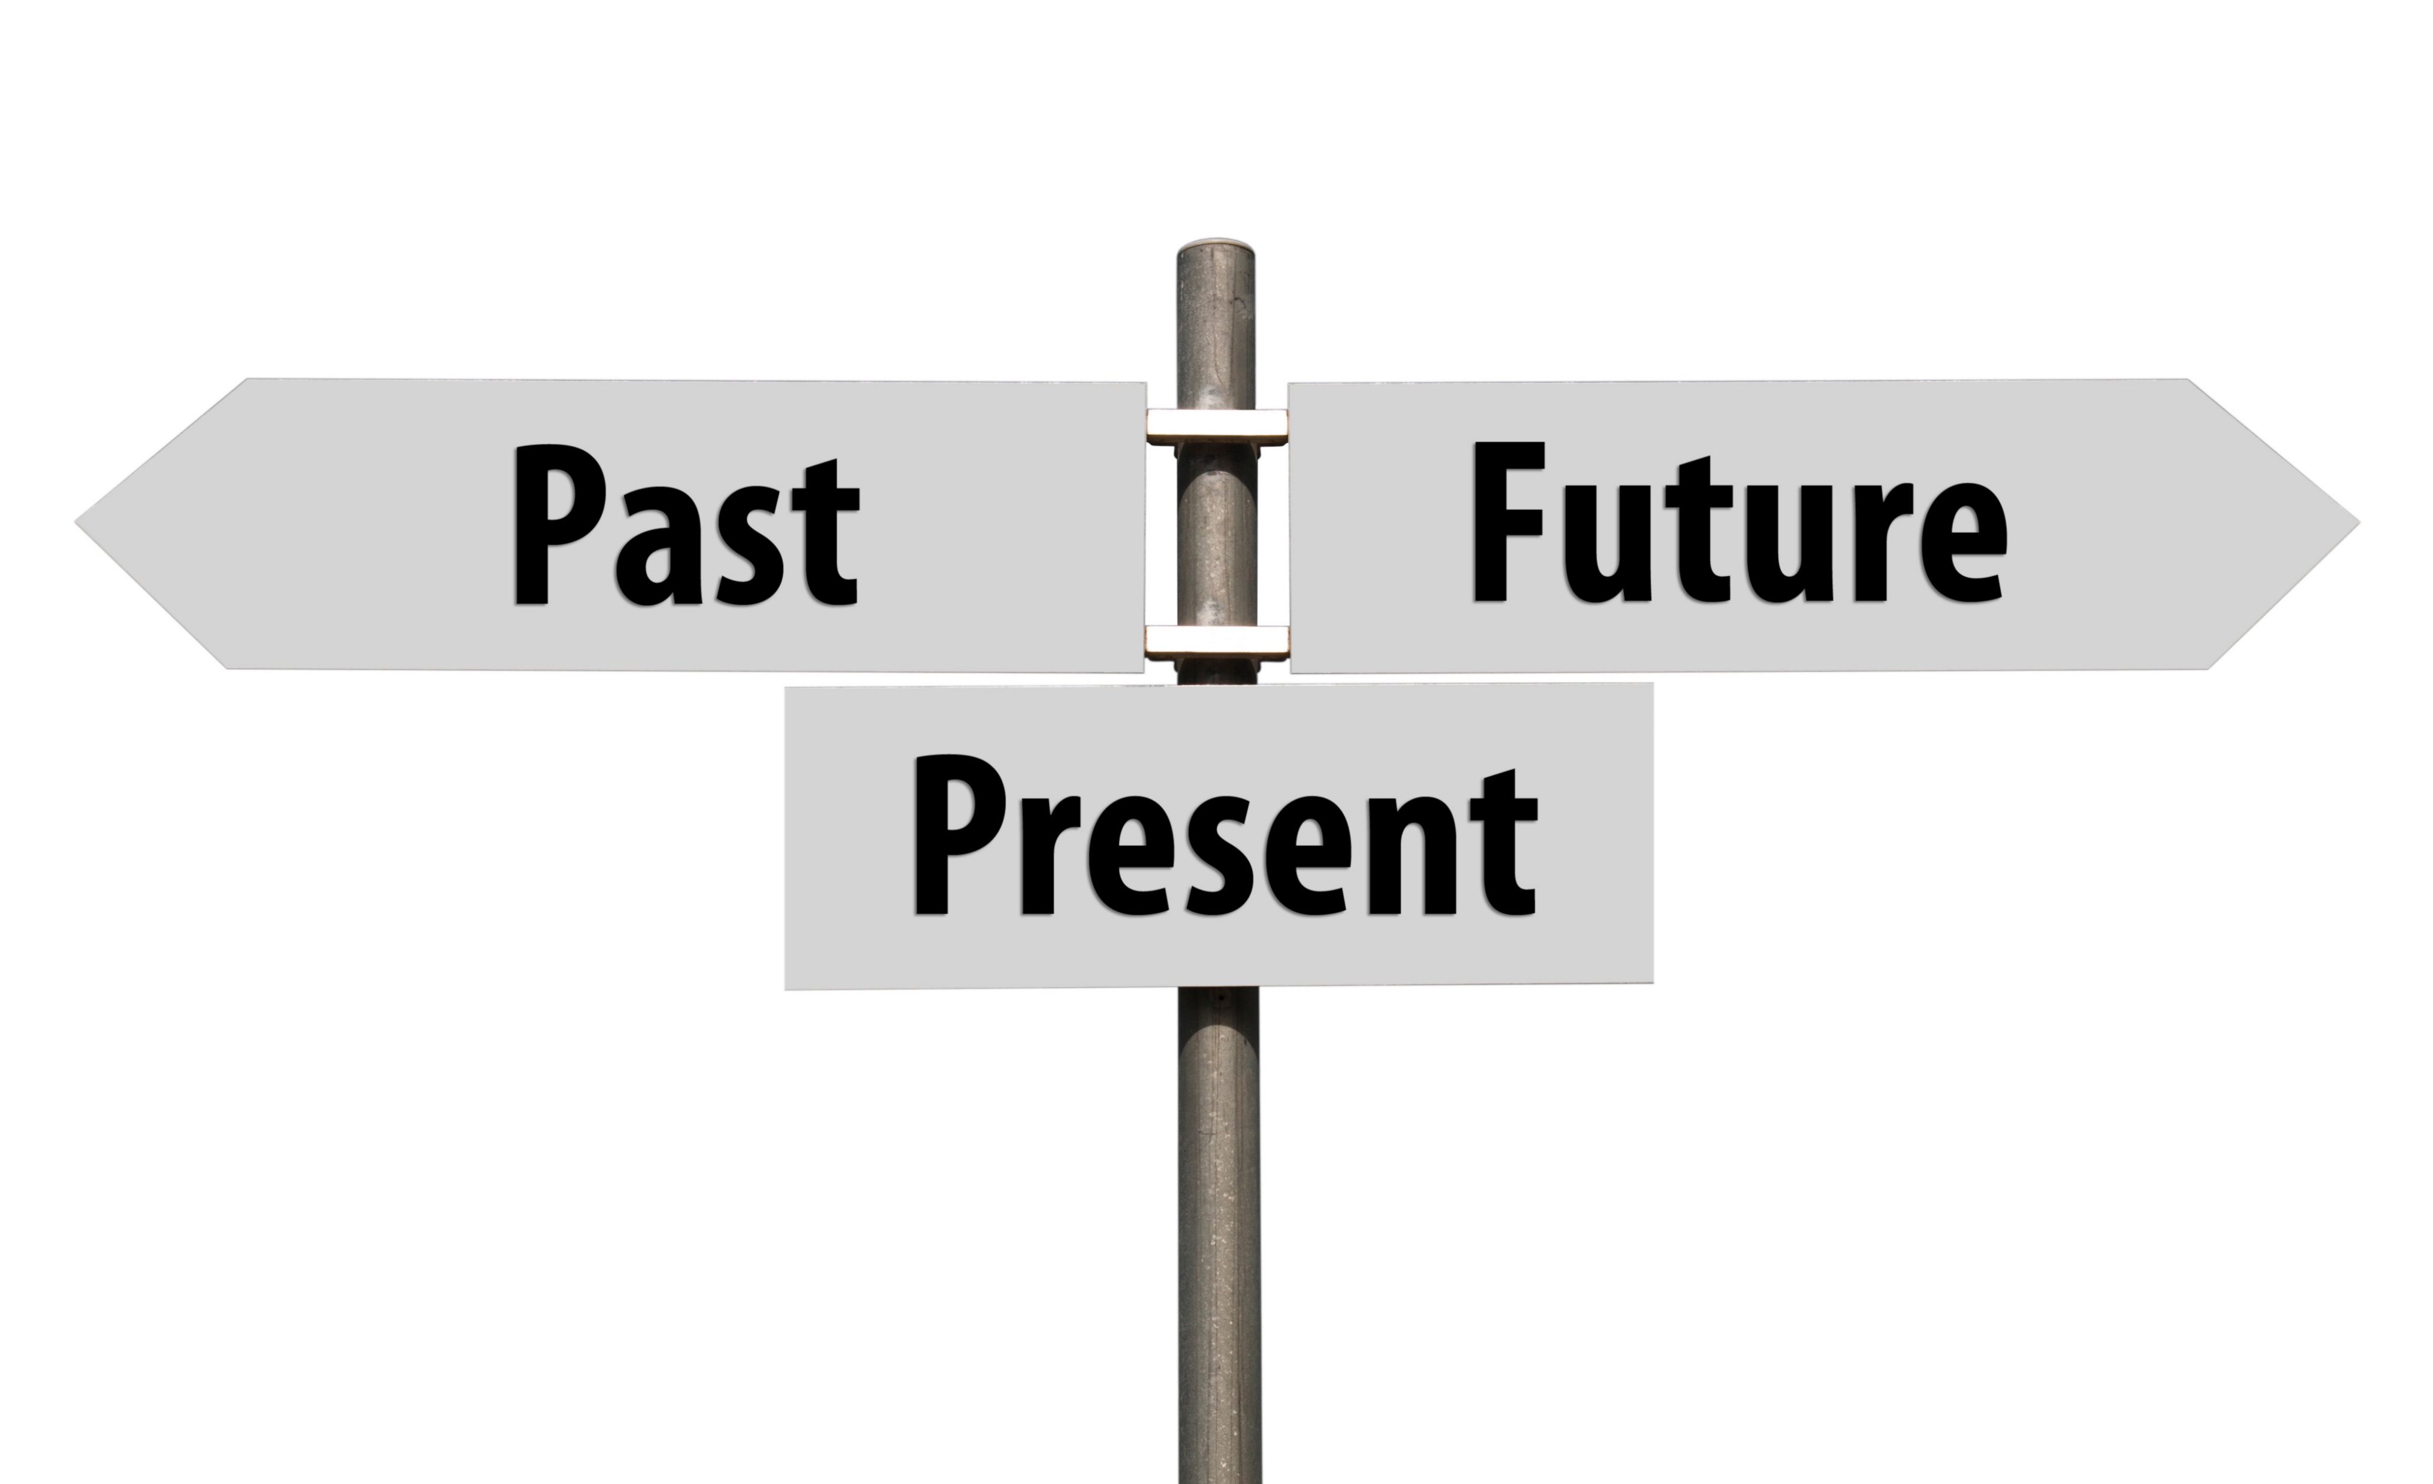


Why CEP Movement
?
Long term, Sustainable, Duplicable, Profitable

Slide 3
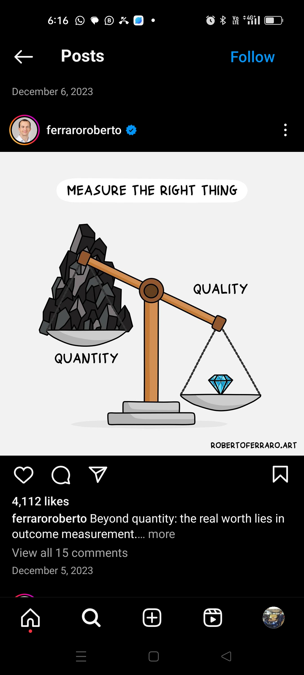
CEP Movement
Long term
Sustainable
Duplicable
Profitable
Dream = CEP > Products Use > Massive Action

Slide 4
CEP Movement
Long term, Sustainable, Duplicable, Profitable
No CEP - No Dream
No CEP - No Leadership
No CEP - No Duplication
No CEP - No Profitability
No CEP - No Sustainability
No CEP - No Growth
No CEP - No Attitude
No CEP - No Harmony

Slide 5
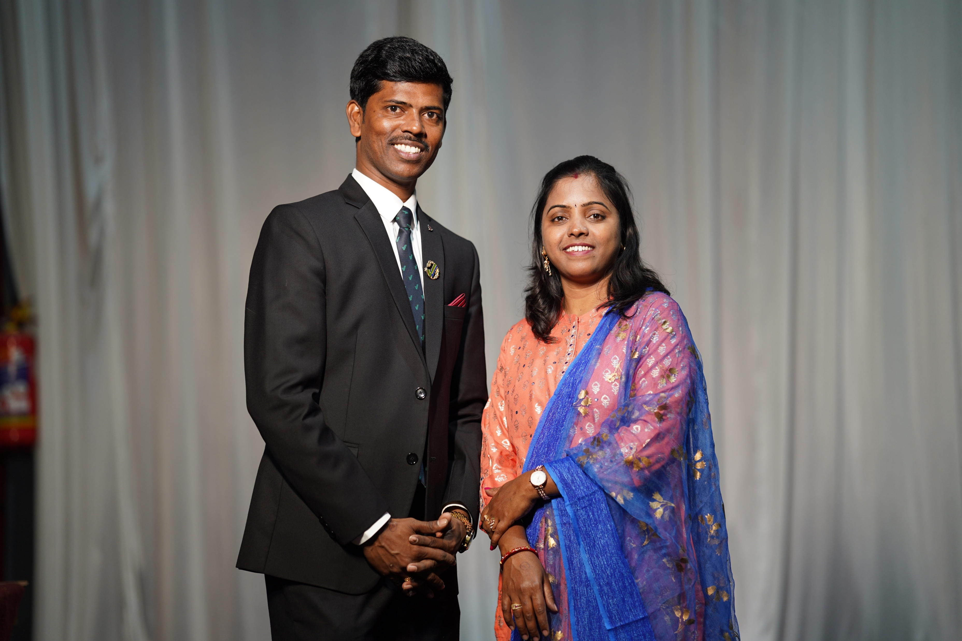


Right
Information is your Success
?
799 / 365 days
= 2.18 P/Day

Slide 6
IS YOUR LEADERSHIP ON CEP?
CEP Movement
IN YOUR TEAM
BRONZE GROUP SHOULD HAVE - 10 CEP
DIAMOND GROUP SHOULD HAVE – 50 CEP
CROWN GROUP SHOULD HAVE – 100 CEP
Let's Start CEP Movement

Slide 7

